Slide 1
Assignment 1
Perform the following operations using Python on suitable data sets:
Read data from different formats (like csv, xls)
Find Shape of Data
Find Missing Values
Find data type of each column
Finding out Zero's
Indexing and selecting data, sort data,
Describe attributes of data, checking data types of each column,
counting unique values of data, format of each column, converting variable data type (e.g. from long to short, vice versa)

Slide 2
Assignment 2
Perform the following operations using Python on the data sets:
Compute and display summary statistics for each feature available in the dataset. (e.g. minimum value, maximum value, mean, range, standard deviation, variance and percentiles
Illustrate the feature distributions using histogram.
Data cleaning, Data integration, Data transformation, Data model building (e.g. Classification)

Slide 3
2. Data Wrangling, IN Perform the following operations using Python on any open source dataset (e.g., data.csv)
a. Import all the required Python Libraries.
b. Locate open-source data from the web (e.g.,https://www.kaggle.com). Provide a clear description of the data and its source (i.e., URL of the web site).
c. Load the Dataset into pandas data frame.
d. Data Preprocessing: check for missing values in the data using pandas isnull(), describe() function to get some initial statistics. Provide variable descriptions. Types of variables etc. Check the dimensions of the data frame.
e. Data Formatting and Data Normalization: Summarize the types of variables by checking the data types (i.e., character, numeric, integer, factor, and logical) of the variables in the data set. If variables are not in the correct data type, apply proper type conversions.
f. Turn categorical variables into quantitative variables in Python.
Practical based on Data Loading, Storage and File Formats

Slide 4
Data Wrangling
Data Wrangling is the process of gathering, collecting, and transforming Raw data into another format for better understanding, decision-making, accessing, and analysis in less time. Data Wrangling is also known as Data Munging.

Slide 5
Importance Of Data Wrangling
Books selling Website want to show top-selling books of different domains, according to user preference. For example, if a new user searches for motivational books, then they want to show those motivational books which sell the most or have a high rating, etc.
But on their website, there are plenty of raw data from different users. Here the concept of Data Munging or Data Wrangling is used. As we know Data wrangling is not by the System itself. This process is done by Data Scientists. So, the data Scientist will wrangle data in such a way that they will sort the motivational books that are sold more or have high ratings or user buy this book with these package of Books, etc. On the basis of that, the new user will make a choice. This will explain the importance of Data wrangling.

Slide 6
Data Wrangling in Python
Data Wrangling is a crucial topic for Data Science and Data Analysis. Pandas Framework of Python is used for Data Wrangling. Pandas is an open-source library in Python specifically developed for Data Analysis and Data Science. It is used for processes like data sorting or filtration, Data grouping, etc

Slide 7
Data wrangling in Python deals with the below functionalities:
Data exploration: In this process, the data is studied, analyzed, and understood by visualizing representations of data.
Dealing with missing values: Most of the datasets having a vast amount of data contain missing values of NaN, they are needed to be taken care of by replacing them with mean, mode, the most frequent value of the column, or simply by dropping the row having a NaN value.
Reshaping data: In this process, data is manipulated according to the requirements, where new data can be added or pre-existing data can be modified.
Filtering data: Some times datasets are comprised of unwanted rows or columns which are required to be removed or filtered
Other: After dealing with the raw dataset with the above functionalities we get an efficient dataset as per our requirements and then it can be used for a required purpose like data analyzing, machine learning, data visualization, model training etc.

Slide 8
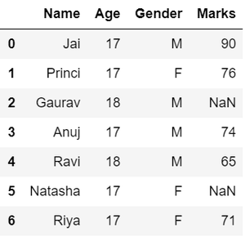
Data exploration in Python
# Import pandas package
import pandas as pd
# Assign data
data = {'Name': ['Jai', 'Princi', 'Gaurav','Anuj', 'Ravi', 'Natasha', 'Riya'],
'Age': [17, 17, 18, 17, 18, 17, 17],
'Gender': ['M', 'F', 'M', 'M', 'M', 'F', 'F'],
'Marks': [90, 76, 'NaN', 74, 65, 'NaN', 71]}
# Convert into DataFrame
df = pd.DataFrame(data)
# Display data
df

Slide 9
Dealing with missing values in Python
As we can see from the previous output, there are NaN values present in the MARKS column which is a missing value in the dataframe that is going to be taken care of in data wrangling by replacing them with the column mean.

Slide 10
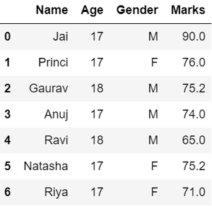
# Compute average
c = avg = 0
for ele in df['Marks']:
if str(ele).isnumeric():
c += 1
avg += ele
avg /= c
# Replace missing values
df = df.replace(to_replace="NaN",value=avg)
# Display data
df

Slide 11
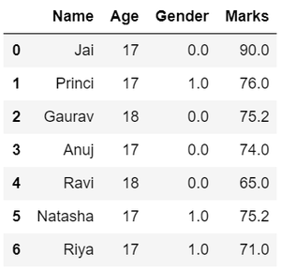
Data Replacing in Data Wrangling
In the GENDER column, we can replace the Gender column data by categorizing them into different numbers.
# Categorize gender
df['Gender'] = df['Gender'].map({'M': 0,'F': 1, }).astype(float)
# Display data
df

Slide 12
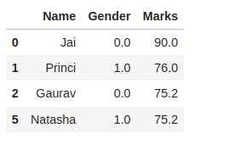
Filtering data in Data Wrangling
suppose there is a requirement for the details regarding name, gender, and marks of the top-scoring students. Here we need to remove some using the pandas slicing method in data wrangling from unwanted data.
# Filter top scoring students
df = df[df['Marks'] >= 75].copy()
# Remove age column from filtered DataFrame
df.drop('Age', axis=1, inplace=True)
# Display data
df

Slide 13
Data Wrangling Using Merge Operation
Merge operation is used to merge two raw data into the desired format.
Syntax: pd.merge( data_frame1,data_frame2, on=”field “)
Here the field is the name of the column which is similar in both data-frame.
For example: Suppose that a Teacher has two types of Data, the first type of Data consists of Details of Students and the Second type of Data Consist of Pending Fees Status which is taken from the Account Office. So The Teacher will use the merge operation here in order to merge the data and provide it meaning. So that teacher will analyze it easily and it also reduces the time and effort of the Teacher from Manual Merging.

Slide 14
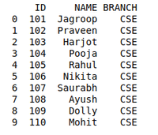
Creating First Dataframe to Perform Merge Operation using Data Wrangling:
# import module
import pandas as pd
# creating DataFrame for Student Details
details = pd.DataFrame({
'ID': [101, 102, 103, 104, 105, 106,
107, 108, 109, 110],
'NAME': ['Jagroop', 'Praveen', 'Harjot',
'Pooja', 'Rahul', 'Nikita',
'Saurabh', 'Ayush', 'Dolly', "Mohit"],
'BRANCH': ['CSE', 'CSE', 'CSE', 'CSE', 'CSE',
'CSE', 'CSE', 'CSE', 'CSE', 'CSE']})
# printing details
print(details)

Slide 15
. Import Required Libraries
import pandas as pd
import numpy as np
a. Read Data from Different Formats (CSV, XLS)
Read CSV file
df_csv = pd.read_csv("data.csv")
Read Excel file
df_xls = pd.read_excel("data.xlsx")

Slide 16
b. Find Shape of Data
df_csv.shape
Output: (rows, columns)
c. Find Missing Values
df_csv.isnull().sum()
To check if any missing values exist:
df_csv.isnull().values.any()

Slide 17
d. Find Data Type of Each Column
df_csv.dtypes
e. Finding Out Zero’s
(df_csv == 0).sum()
For numeric columns only:
(df_csv.select_dtypes(include=np.number) == 0).sum()

Slide 18
f. Indexing, Selecting Data & Sorting
Select a Single Column
df_csv['Column_Name']
Select Multiple Columns
df_csv[['Column1', 'Column2']]
Select Rows using Index
df_csv.iloc[0:5] # first 5 rows
Select Rows using Condition
df_csv[df_csv['Age'] > 20]

Slide 19
Sort Data
df_csv.sort_values(by='Age', ascending=True)
. Describe Attributes & Check Data Types
Statistical Summary
df_csv.describe()
Include All Columns
df_csv.describe(include='all')
Check Data Types Again
df_csv.info()

Slide 20
h. Counting Unique Values, Format & Data Type Conversion
Count Unique Values
df_csv.nunique()
For a specific column:
df_csv['Gender'].value_counts()
heck Format of Each Column
df_csv.applymap(type)
Convert Variable Data Type
Integer to Float
df_csv['Marks'] = df_csv['Marks'].astype(float)
Float to Integer
df_csv['Marks'] = df_csv['Marks'].astype(int)
Object to Category
df_csv['Department'] = df_csv['Department'].astype('category')

Slide 21
Student_ID,Name,Age,Gender,Department,Marks,Attendance,Internship

